Slide 1
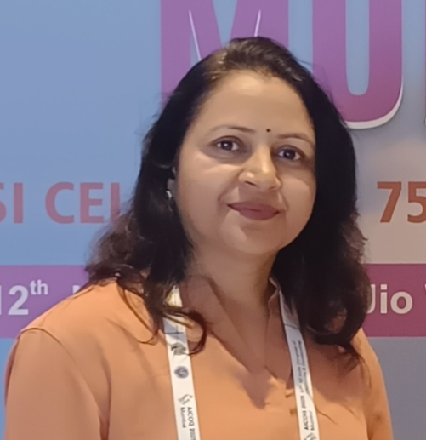
Name- Dr URVASHI VERMA
Designation- Professor
Current affiliation - Dept. of OBGY, S. N. Medical College Agra, Uttar Pradesh
Important Achievements-
FICOG, FICMCH, FIAOG, FMAS, MAMS, CIMP, FICP
Member(Governing council) ICOG(2015-17)
Life member FOGSI, IMS, AGOI UPCOG,AOGS
Awards-
1. 1st Prize Poster competition MS Study 2001
2. Dr. S. K. Ghai Bhandari award AICCRCOG (2013)
3. 2nd Prize NZYUVA FOGSI (2014)
4. Dr. Jagdishwari Mishra award AICOG (2017)
5. Sh. Prabhu Dayal Baweja UPCOG(2017
Academic achievements-
More than 50 publications in national & international journal
Many chapters contributed in various books
On editorial board and reviewer in many reputed journal
Participated as faculty in international, national and state conferences

